Slide 1
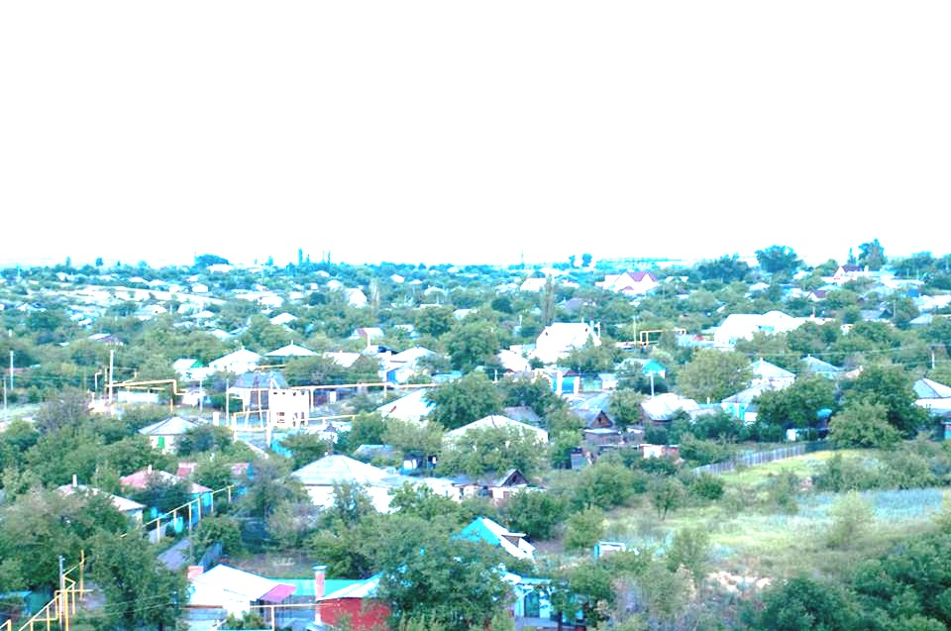
Mythological reception of satellite TV in oral culture (on the case of Russian rural media environment)
Ilya Kiriya, Anna Novikova, Varvara Chumakova,
ikiria@hse.ru
National Research University
Higher School of Economics (Moscow, Russia)

Slide 2
Oral and literate culture in Russia
Traditional Russian culture before soviet industrialization and mass literacy education (made by soviet government just after the 1917 revolution) was the oral culture.
As a consequence – very mythologized culture.
A man of oral tradition perceives his unity with the world (although literate man is much more oriented toward construction of boundaries).
In Russian rural areas the process of transition toward literate man was a most conflict one because has not been accompanied by changes in the everyday life.
The conflict:
A literate culture is a something shaping the relationship with the center (central power, authorities etc)
The everyday life remains to be based on the oral tradition.
This dualism is forming particular media practice: television and all mediated culture is perceived like a myth (mediated culture making them isolated in their periphery). Oral culture is forming the impression of being the one world with other Russian people.

Slide 3
Media ecology on 2 ideal types of culture…
‘Space’ and ‘time’ in Oral culture
‘Space’ and ‘time’ in Literate culture
Simultaneous Time – no Past and Future, only Present and Eternal (Lee D. Linear and Non-linear Codifocation of Reality);
Space is sphere without fixed boundaries, not container of smth, dynamic, non-linear, not connected (Carpenter E., McLuhan M. Acoustic Space);
Oral communities are strictly separated from other world, but very familiar inside (Meyrowitz J. From Tribal to Global: A Brief History of Civilization from McLuhanesque Perspective)
Time is linear and has aim in future (Lee D. Linear and Non-linear Codification of Reality);
“Space is imagined as a neutral container, space that is static, linear, continuous, and connected” (McLuhan M., McLuhan E. Laws of Media: The New Science);
“There is a new larger boundary around the nation state, but there are also new internal boundaries around social categories” (Meyrowitz J. From Tribal to Global: A Brief History of Civilization from McLuhanesque Perspective);

Slide 4
Electronic Epoch – challenge for cultures
“New orality” provide non-linear and simultaneous way of social construction of ‘space’ and ‘time’ (McLuhan M. Understanding of Media)
Contemporary environment could be characterized with the idea of “global theater” - mix of different identities, ideals, values reduced to clichés circulates in our environment (McLuhan M., Watson, From Cliché to Archetype).
“The postmodern, electronic matrix leads to more permeable boundaries between different nation states and more permeable boundaries around social categories within nations” (Meyrowitz J. From Tribal to Global: A Brief History of Civilisation from McLuhanesque Perspective)
“The leaning into the future became more of standing up into the present. People stopped thinking about where things were going and started to consider where things were” (Rushkoff D. Present Shock: When Everything Happens Now)

Slide 5
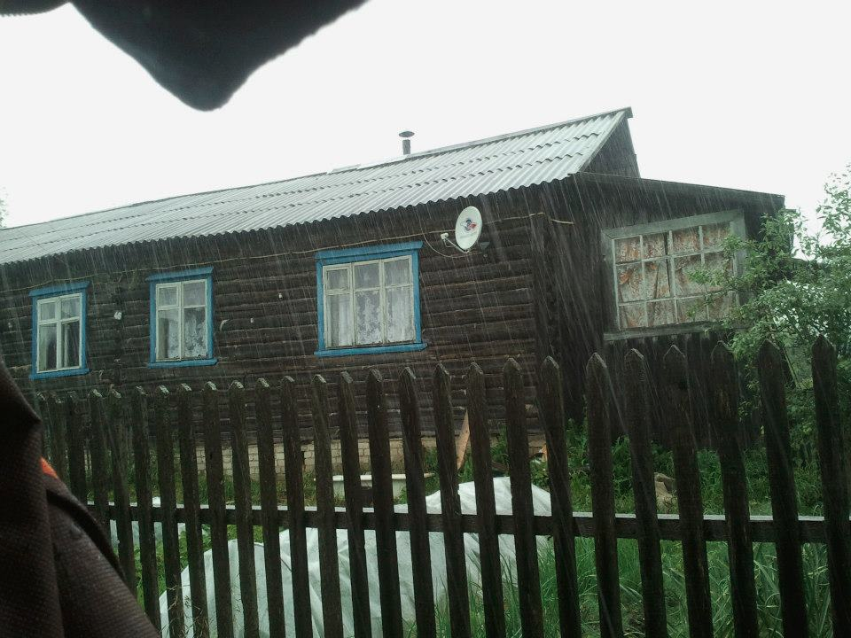
What happens in Russian rural areas?
Laboratory of Media Research, Center of Fundamental Research, HSE
Deep semi-structured interviews and observations:
Kostroma region, 2012 – 33 interviews (with the help of Faculty of Sociology, HSE);
Rostov-on-Don region, 2013 – 59 interviews (with the help of Donskoy State Technical University);
Republic of Tatarstan, 2014 – 49 interviews (with the help of Kazan Federal University).

Slide 6
Mix of orality and new orality
Rural population’s views of time and space is structured by the interaction between traditional orality and media-driven literacy.
From one hand the space is structured and the time is linear, from another hand – orality makes the time only ‘here and now’.
In western culture electronic media (such as movies, radio etc) penetrated into the society with a long tradition of literacy
In Russia electronic communication came quasi simultaneously with the literacy. Such interaction between ‘hot’ media and ‘cold’ or non-literate cultures has been criticized by McLuhan.
Radio and cinema in Russia as a result became means of propaganda (like collective mean) and not the individual entertainment

Slide 7
Audiovisual practices
In their everyday practices rural settlers not use the radio and have an access to movies via television.
The television space seems to be non-structured and converging the real and the fictional
The television time converges the past, the future and the actual.
That’s why people are simultaneously watching television but not trusting it, perceiving the television reality like far from their everyday life. But at the same time they are ready to discuss the television content in categories of ‘good’ and ‘evil’.

Slide 8
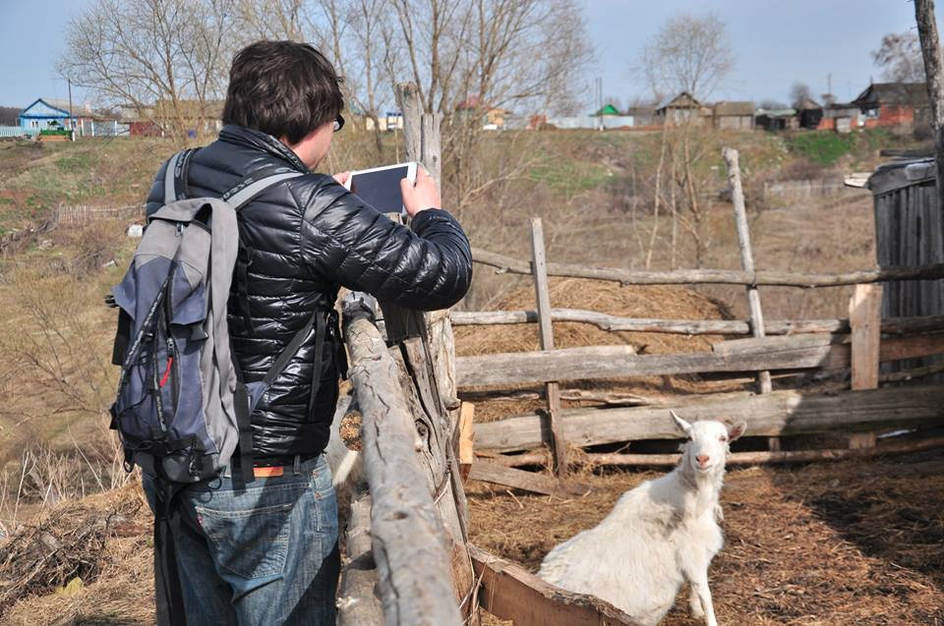
Conclusion
Forced implementation of literacy destroyed in rural consciousness the concept of time disconnecting them from the world and the country.
Rural area became attached to “the center” but detached from another regions (according to rural settlers).
At the same time linearity did not replaced the “here and now” concept of time.
Such process has been enforced by the collapse of the Soviet Union (and its structured concept of space and time).
Thus rural settlers are lost between oral and literate culture, between visual and acoustic spaces.
Actual rural culture is based on ternary model (which is confronting with binary culture of written communication).
Such ternary model converges orthodox binary culture with the pagan one (Lotman).

